Slide 1

Stray Animal Rescue Center System
Application Engineer & Dev
Team WaterPass
Yukun Yuan 001446639
Mingyu Liu 001498402
Mibin Zhu 001424937

Slide 2
CONTENT
01
02
03
04
Problem Statement
Approach
Object Model
Use Cases & Screenshots

Slide 3
Part One
Problem Statement

Slide 4

Problem Statement
With the growing number of stray animals, the rescue measures for them has gradually become a problem that requires more social attentions. The problems can be roughly divided into following three parts.

Slide 5
Problem Statement
Rescue Center
The management of stray animals in the rescue center is not good enough to deal with different species.
Adopter Center
Lack the review and screening process of the adopter information which results in inconvenient information exchange.
Pet Hospital
If the sick stray animal can be sent to the hospital that is most suitable for it, the cure rate will be greatly improved.
01
02
03

Slide 6
Part Two
Approach

Slide 7
Approach
The purpose of this project is to build a unified stray animal rescue system which combines the rescue center, pet hospital and adopter center all together.
By doing so, the whole rescue process can be more convenient and mature, injured stray animals can be directly sent to the hospital which has higher success rate; adopters can also selectively adopt stray animals according to their personal circumstances.

Slide 8
Approach
1
2
3
4
Request Transfer & Information Queue
OOD pattern
Design Module
Implementation Process
Use Facade pattern to reduce the coupling between different classes; and use Factory method pattern to gain good scalability.
The waterfall model is a project development architecture, the development process is developed by designing a series of stages.
Based on transferring the request, the curing animal process, the adopter verify process, the adopt animal process will be realized. In order to improve the efficiency of information transmission, every enterprises maintains its own information queue.
Top-down design and Bottom-up implementation, reduce the development difficulty through structured processes.

Slide 9
Part Three
Object Model

Slide 10
Object Model
System
Network
Enterprise
In our system, we can create multiple networks as different cities, such as Boston or New York.
Under each Enterprise Directory, we can create multiple enterprises in each particular type.
Network
Enterprise Directory
Enterprise
Enterprise Directory
Organization
For each Network area, there exist three enterprises directory, which is Rescue Center, Pet Hospital, Adopter Center.
Organization
In each enterprise, there exist two roles, the manager role and the employee role, for each role, they will have their own responsibility range.

Slide 11
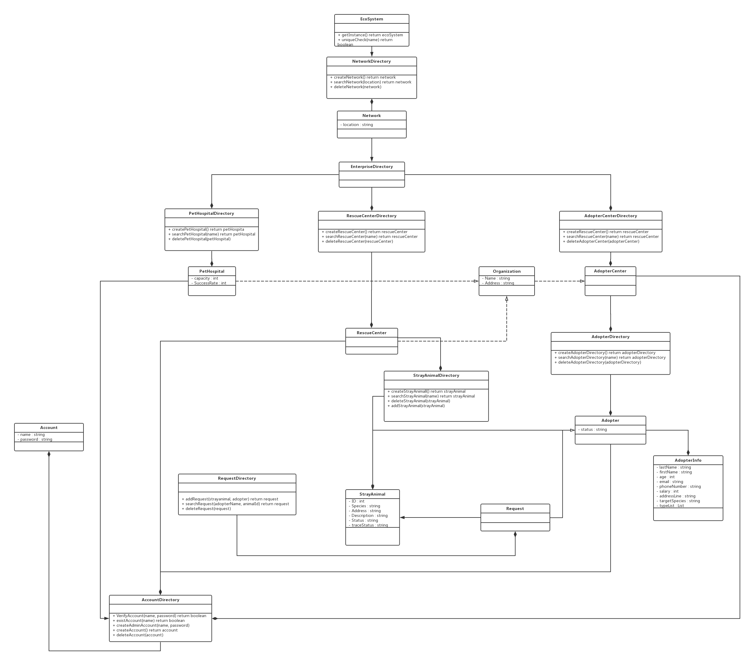
Object Model

Slide 12
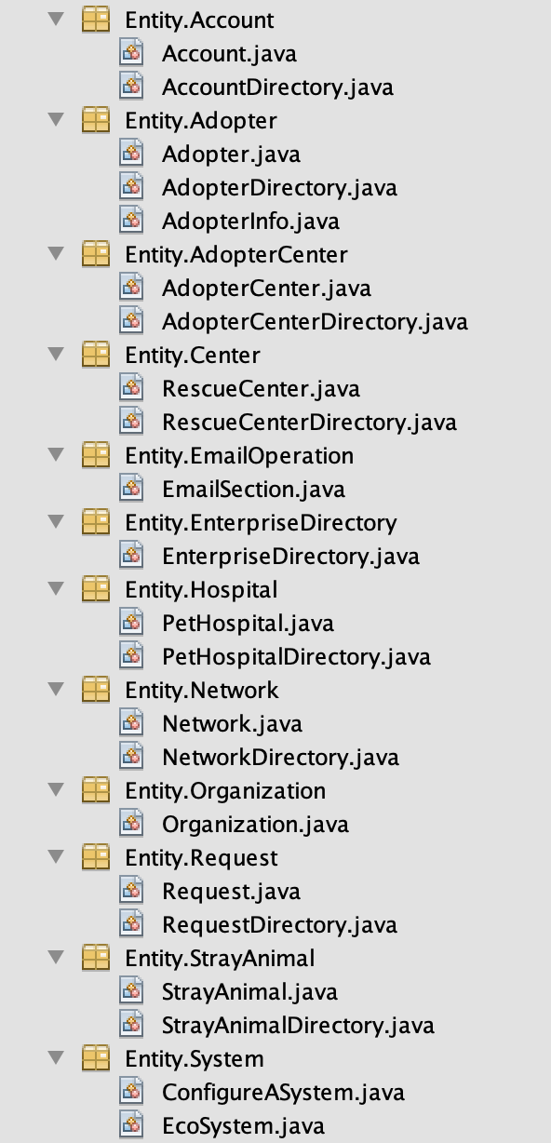
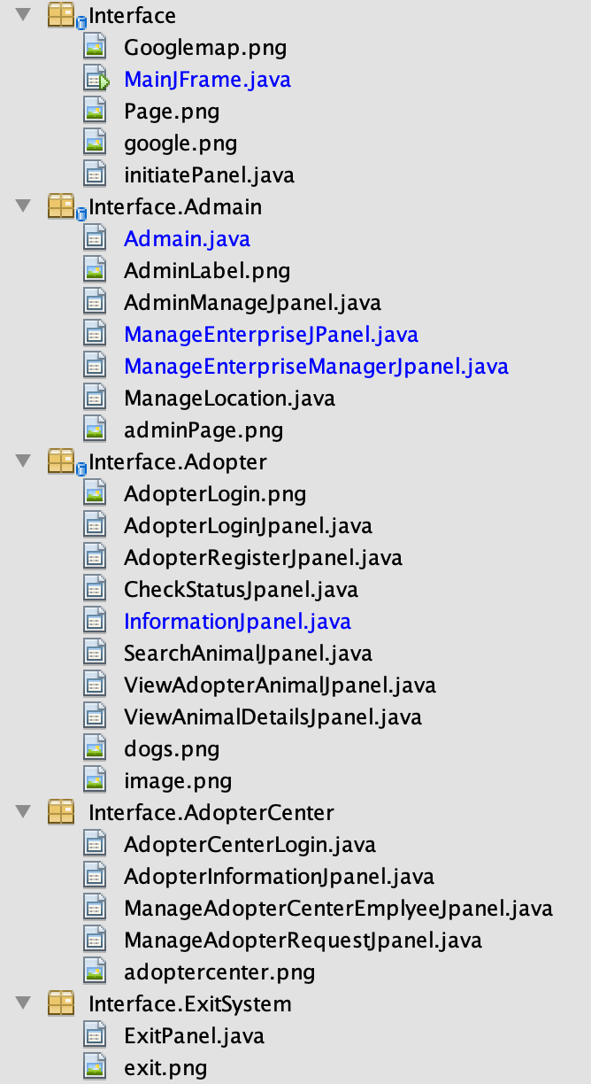
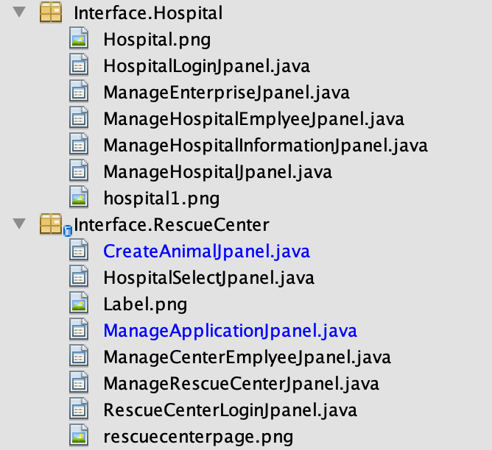

Slide 13
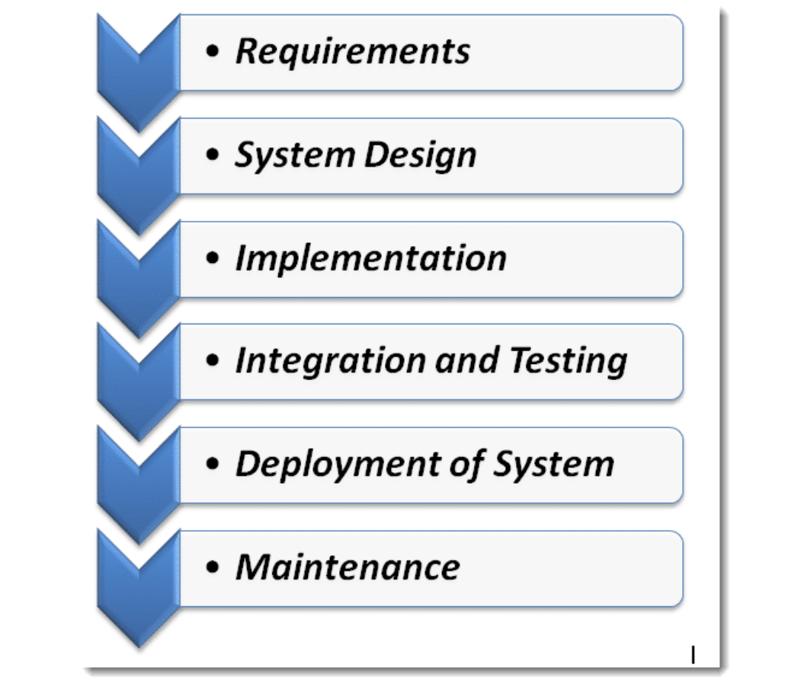
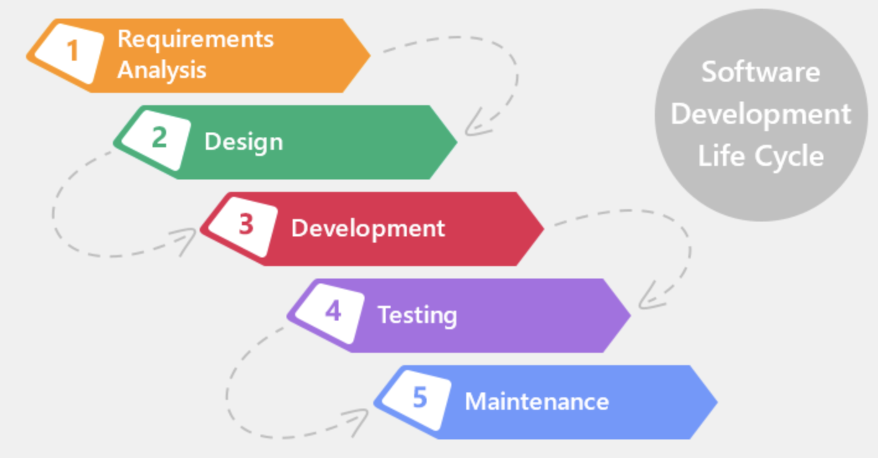
Object Model
Software Development Life Cycle
Waterfall Model

Slide 14
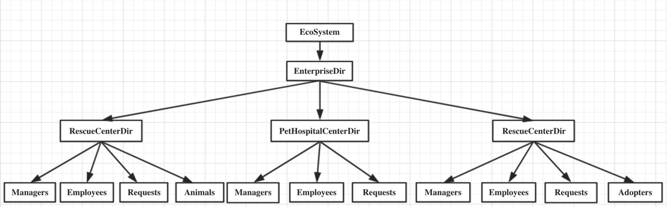
Object Model

Slide 15
Part Four
Use Cases & Screenshots

Slide 16

Network
Login as an default admin role;
Create each network locations;
Create and manage all the Enterprises in each network location;
Create and manage all the manager account for each enterprise;
View all the account information for different manager in different enterprise;

Slide 17
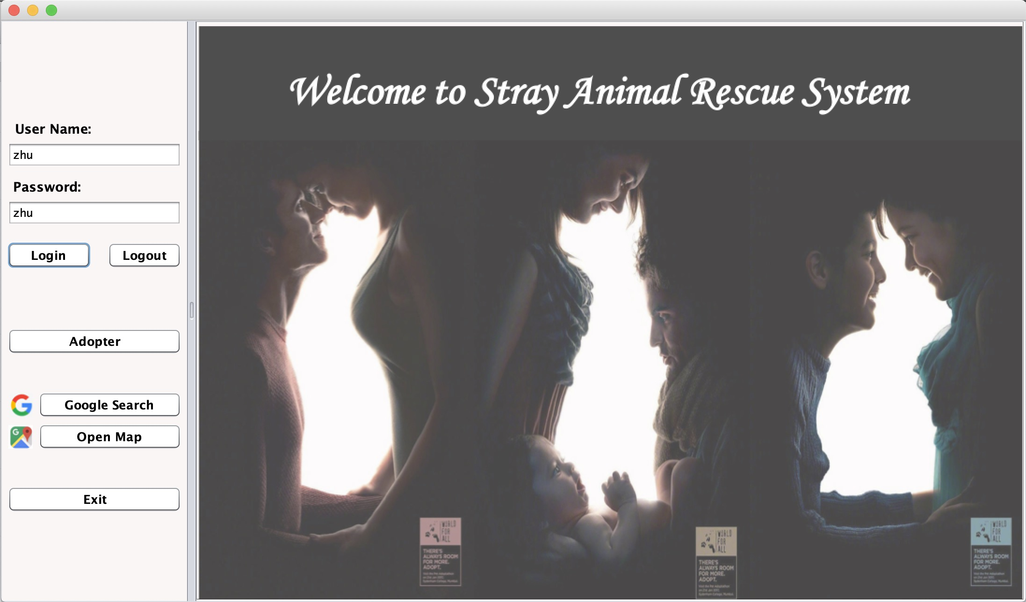

Slide 18
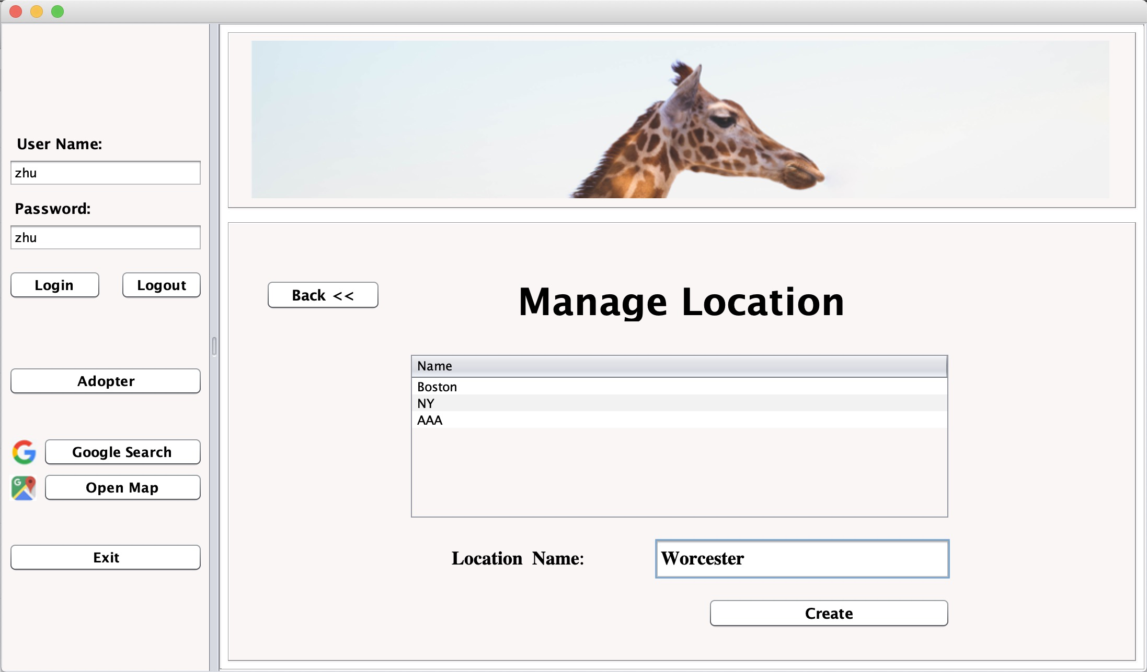

Slide 19
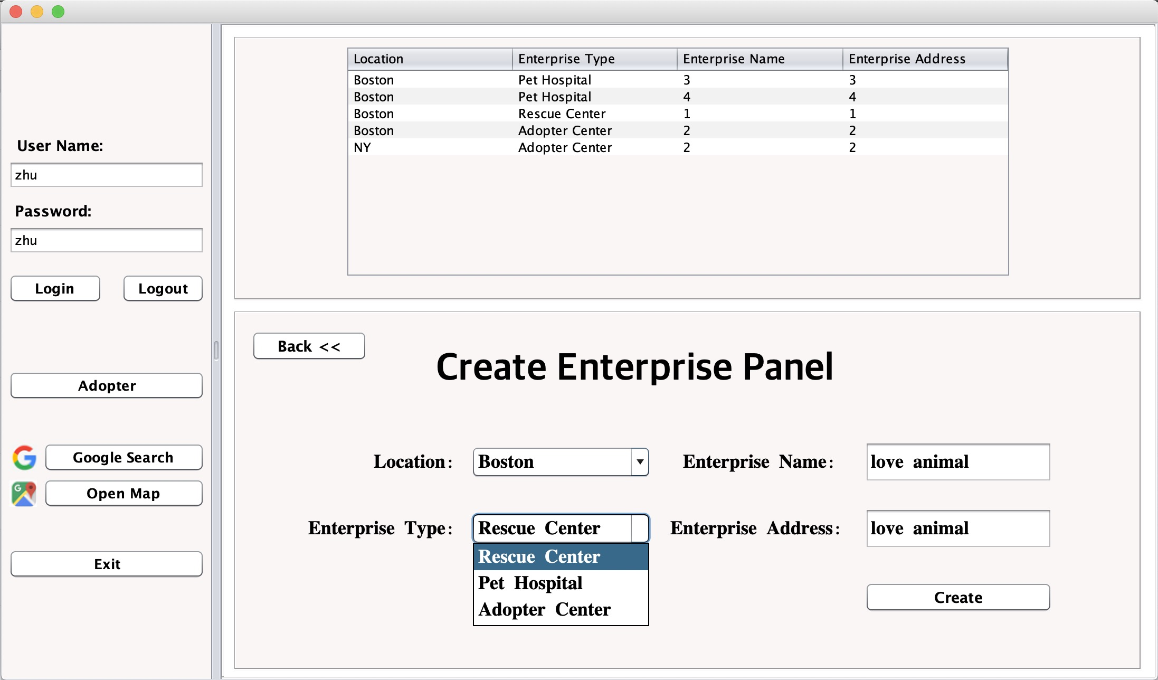

Slide 20
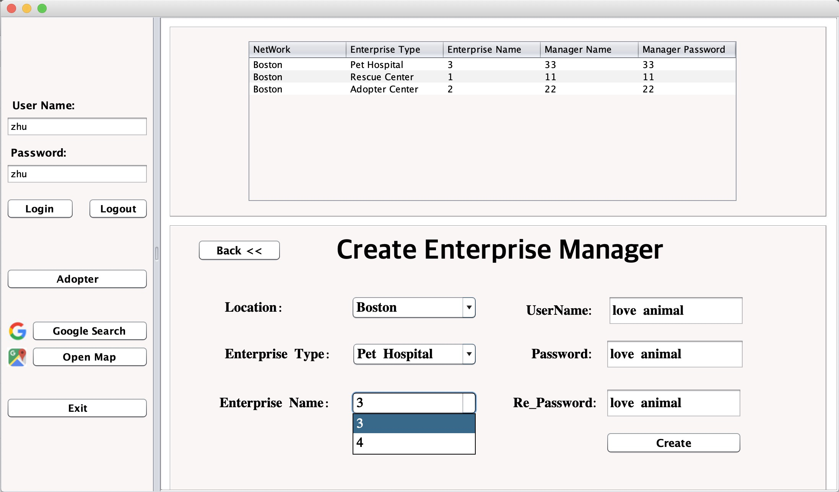

Slide 21

Rescue Center
Login as a manager role or an employee role;
As a manager, I can create, edit or even delete an employee in the rescue center;
As an employee, I can create, view or delete a stray animal;
As an employee, I can choose stray animal with disease and sent to the best pet hospital;
As an employee, I can manage adopter request by choosing reject or accept;

Slide 22
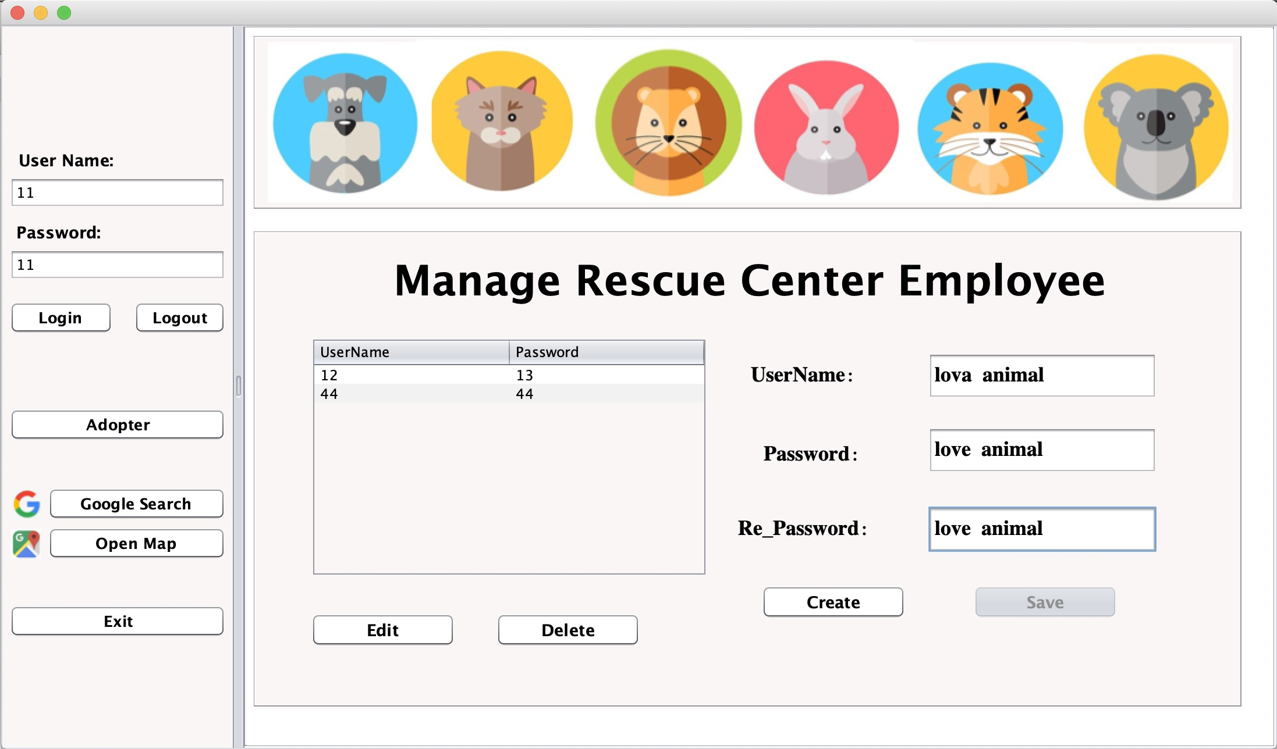

Slide 23
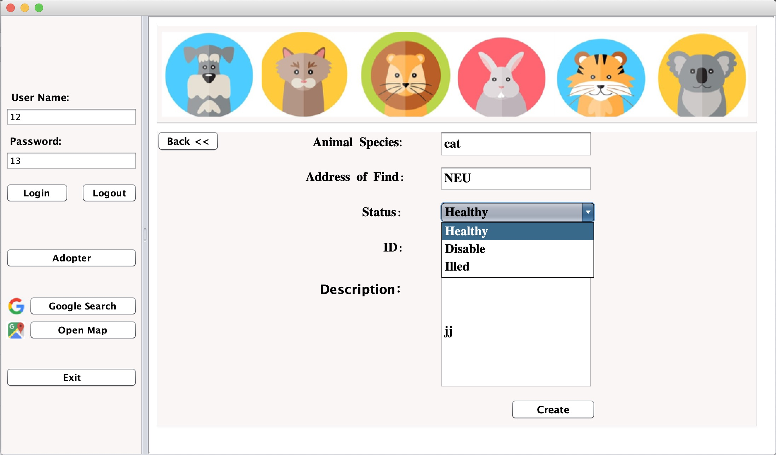

Slide 24
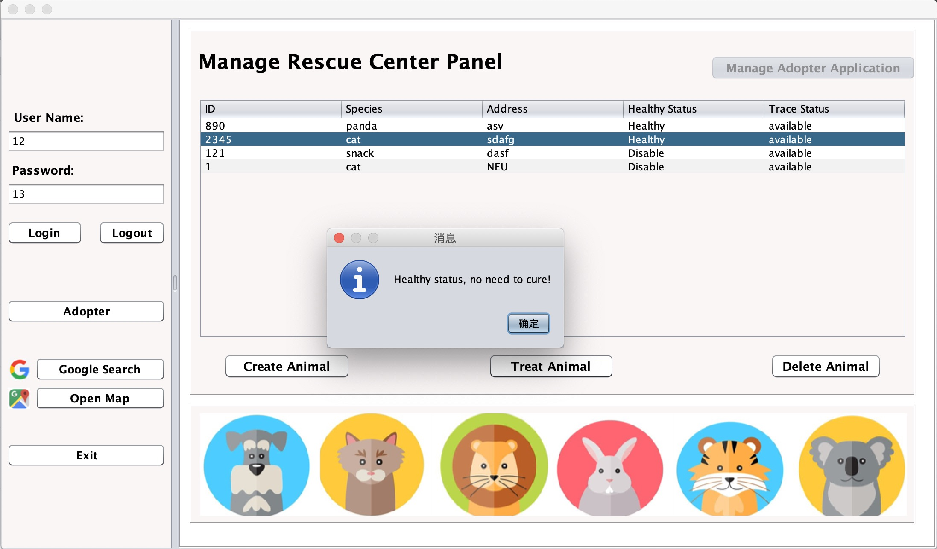

Slide 25
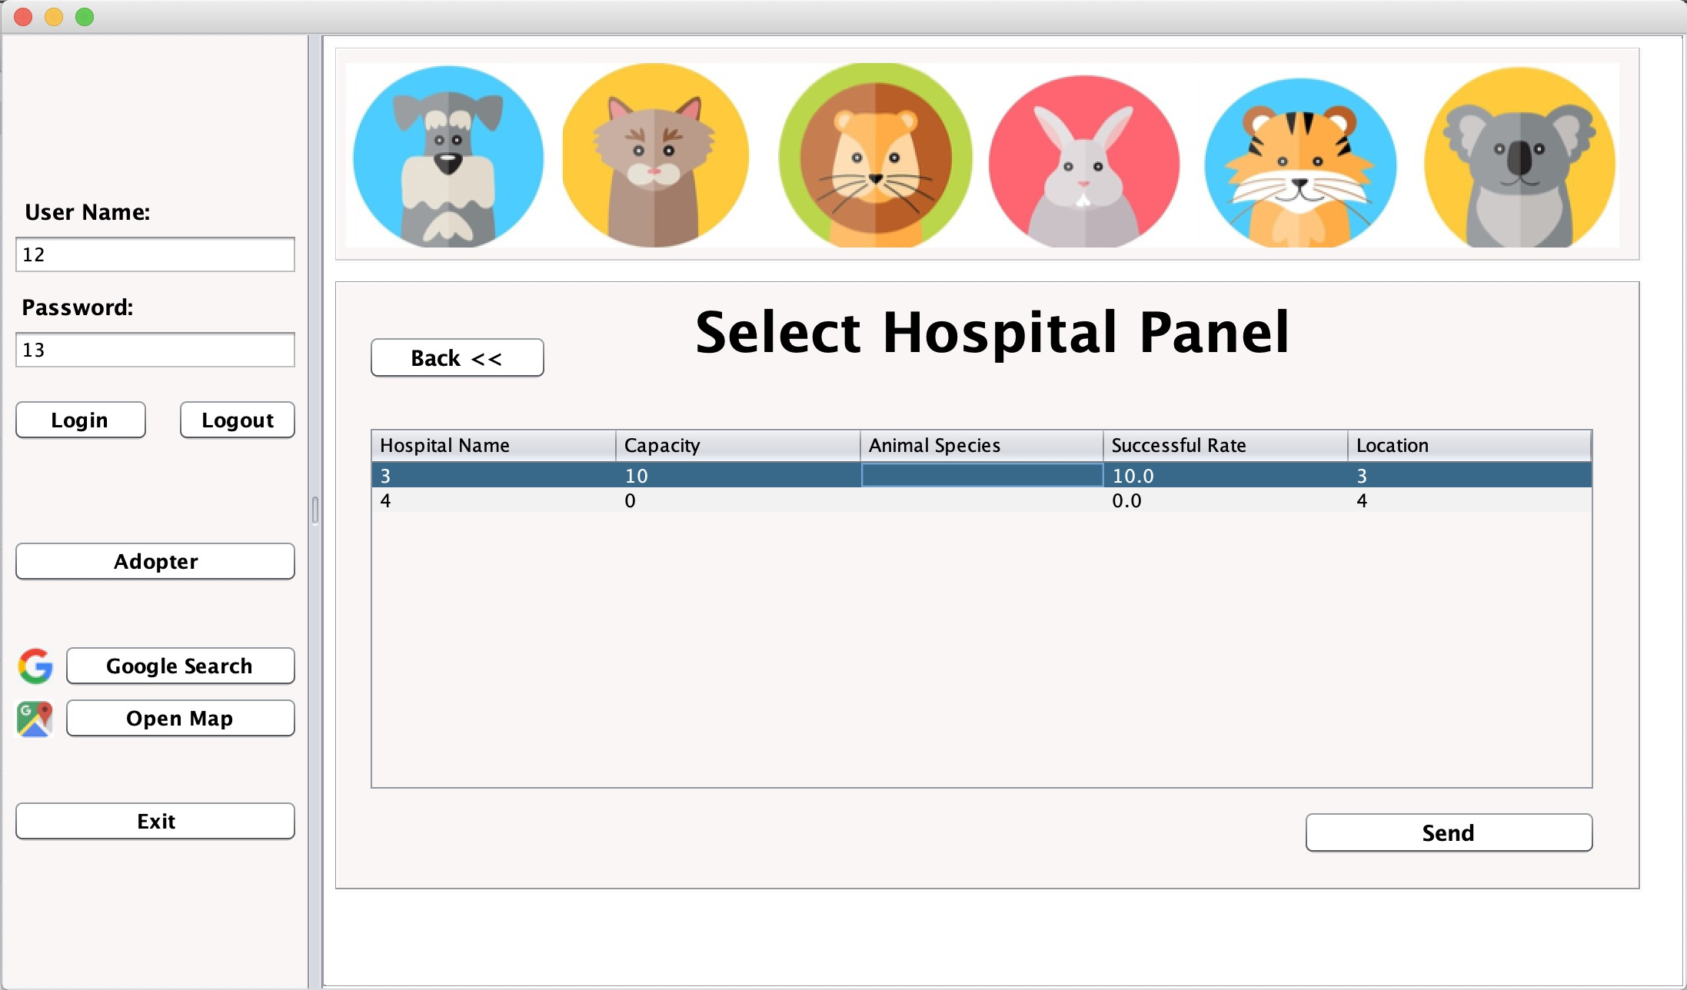

Slide 26
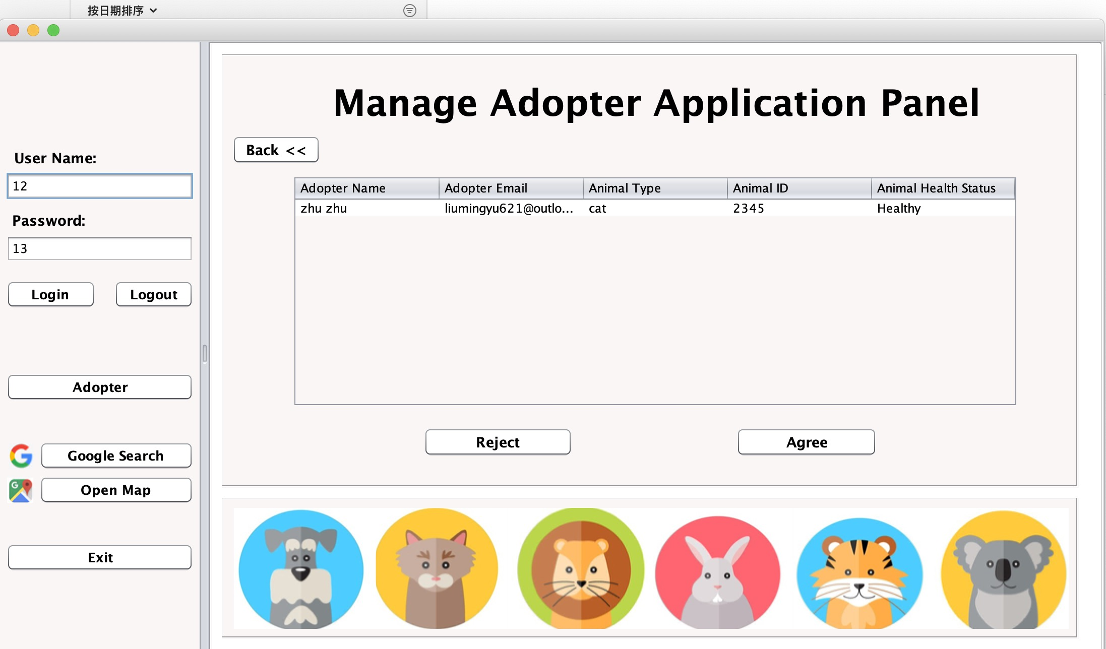

Slide 27
Pet Hospital
Login as a manager role or an employee role;
As a manager, I can create, edit or even delete an employee in the pet hospital;
As a manager, I can create and change hospital capacity and success rate;
As an employee, I can accept or reject the stray animal sent from the rescue center and cure them with particular success rate;

Slide 28
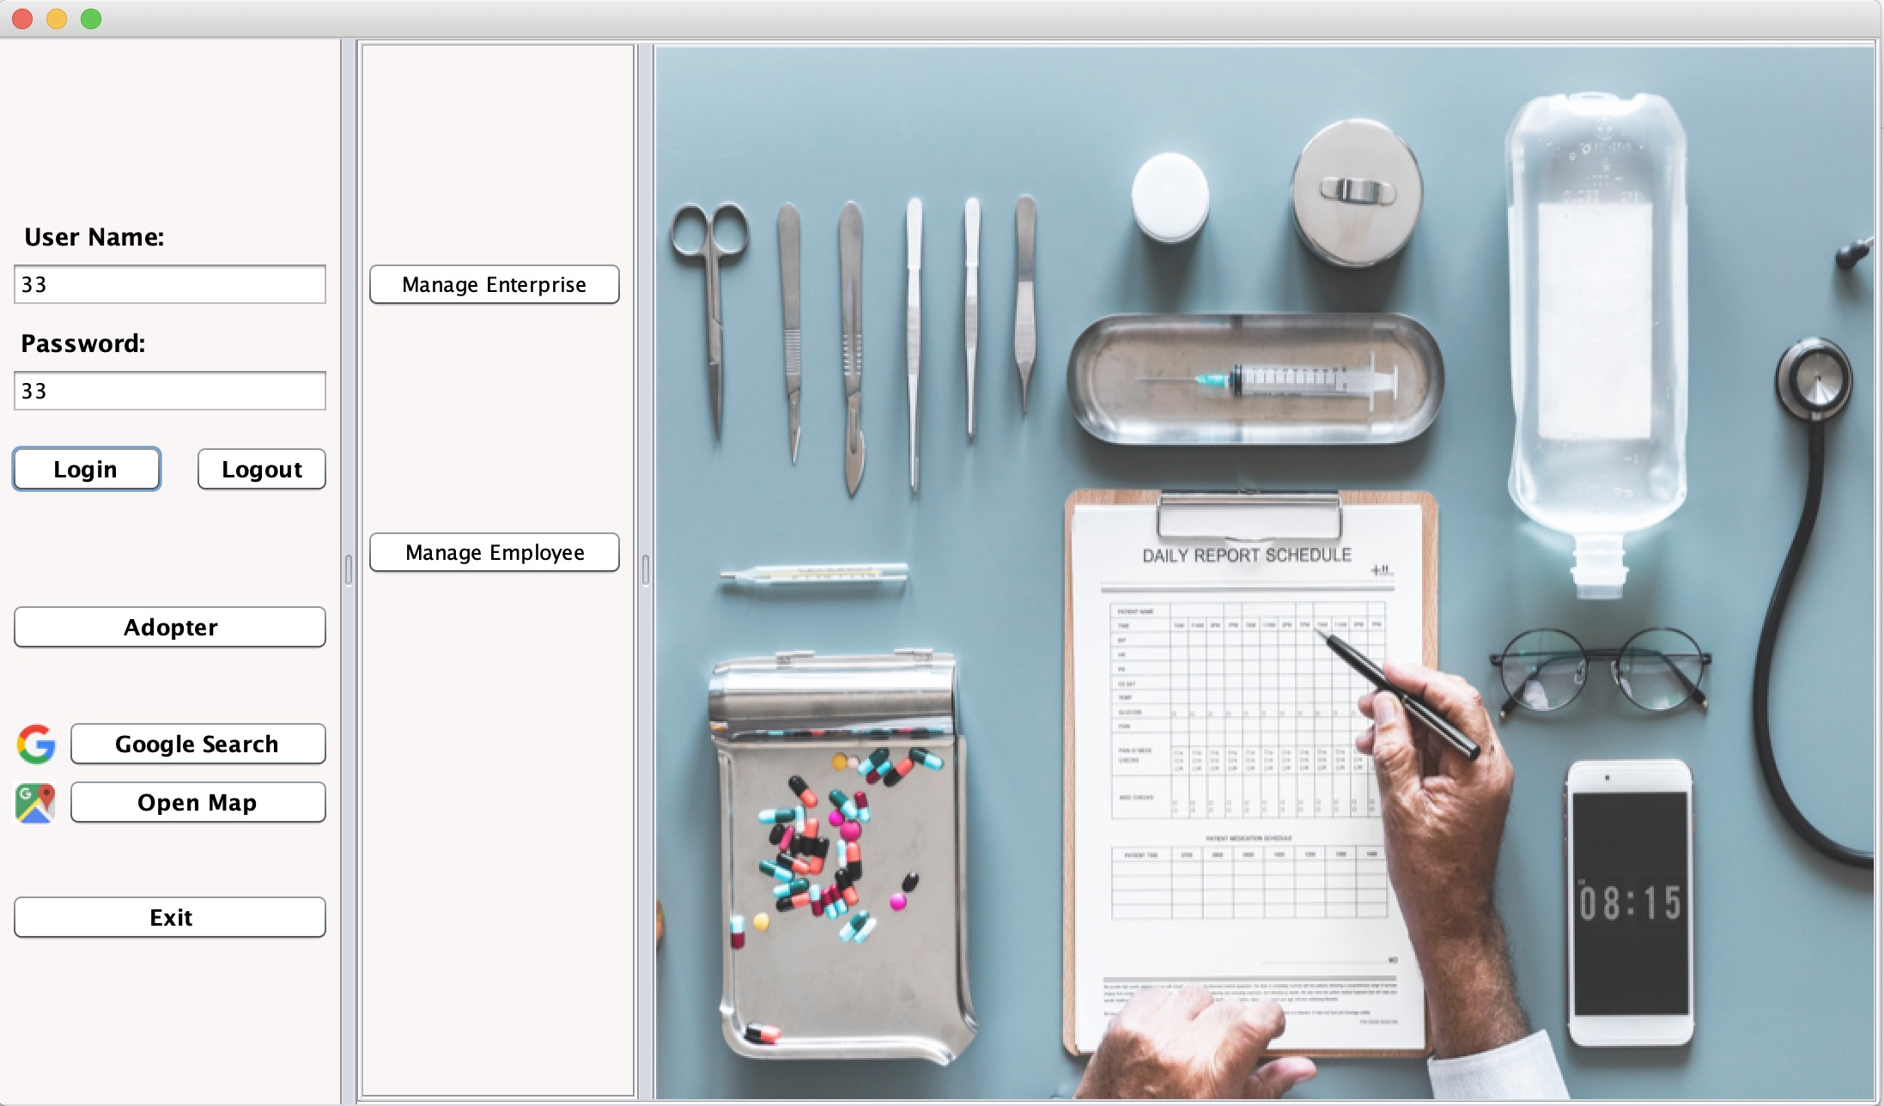

Slide 29
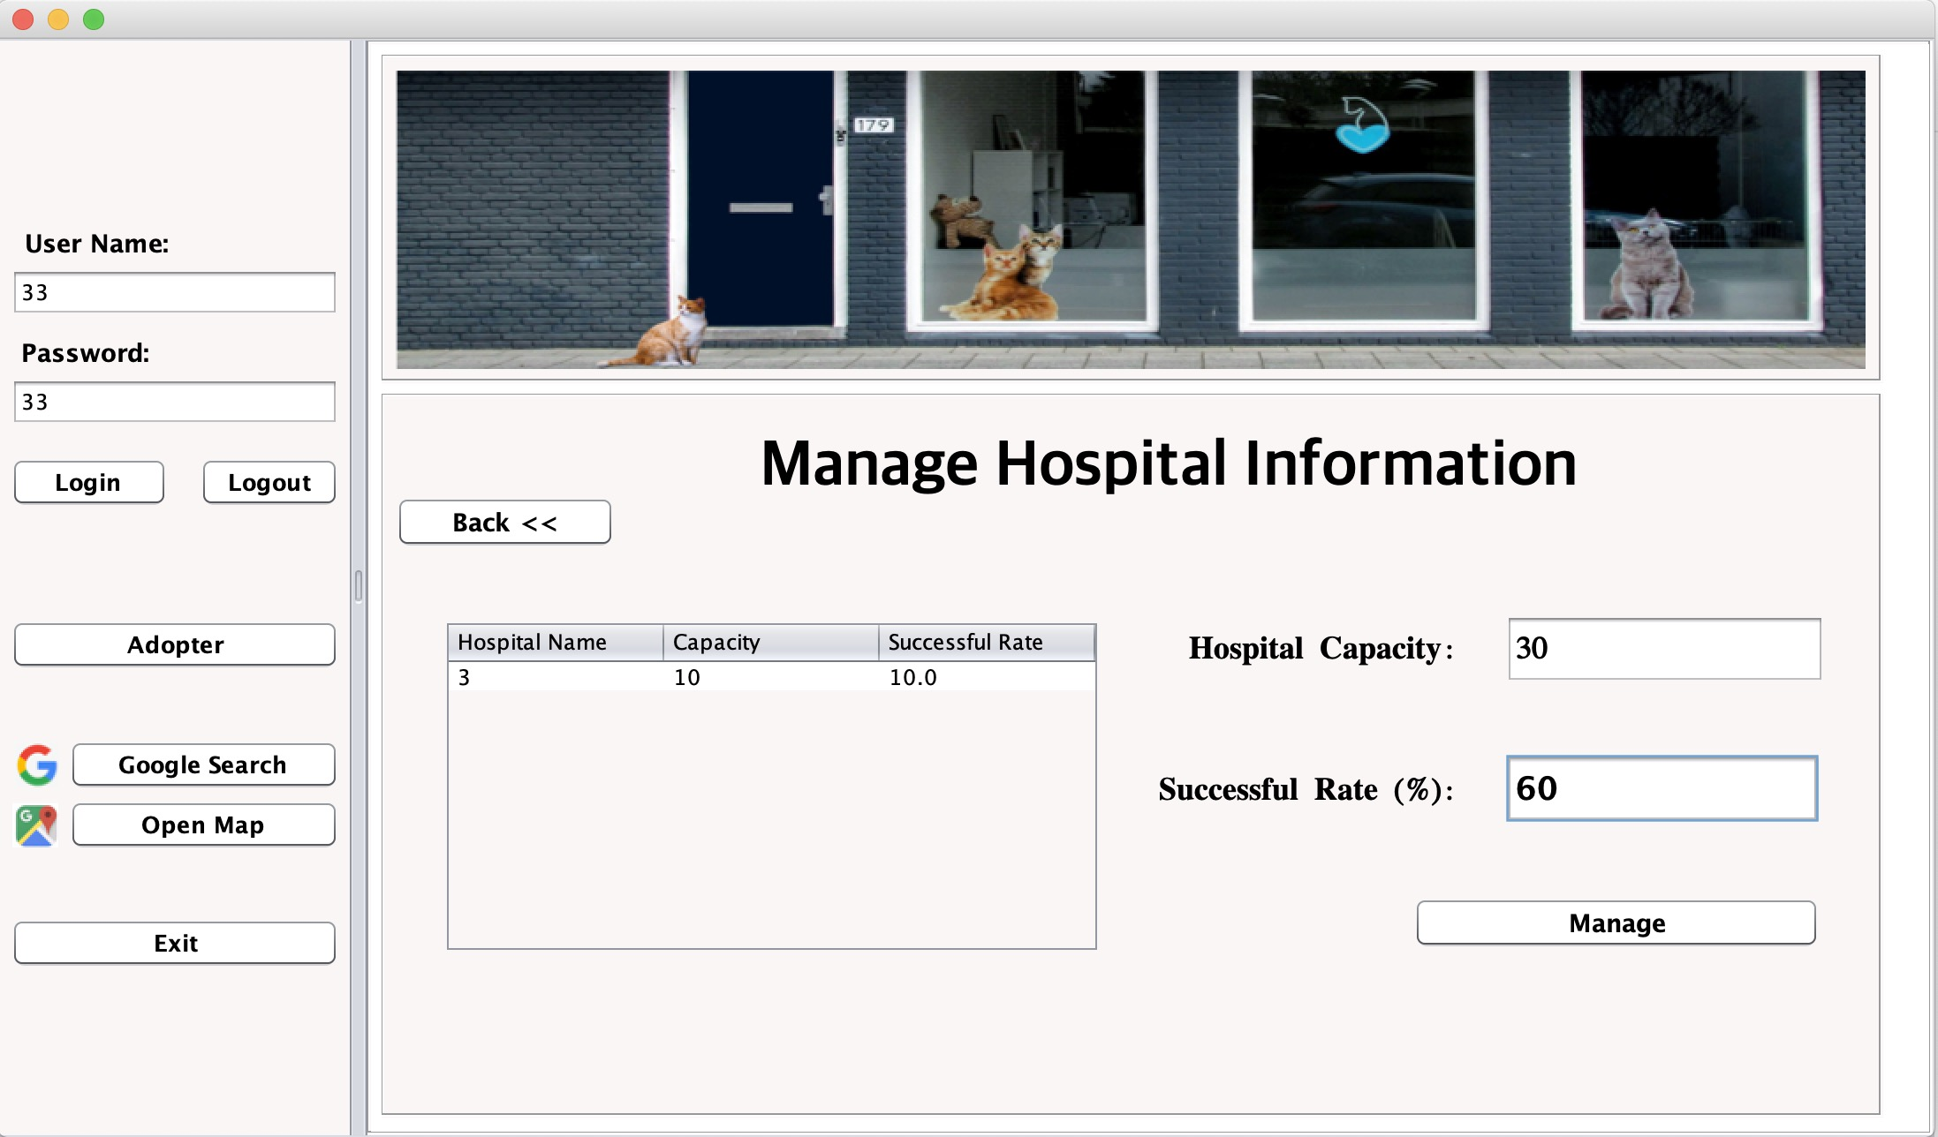

Slide 30
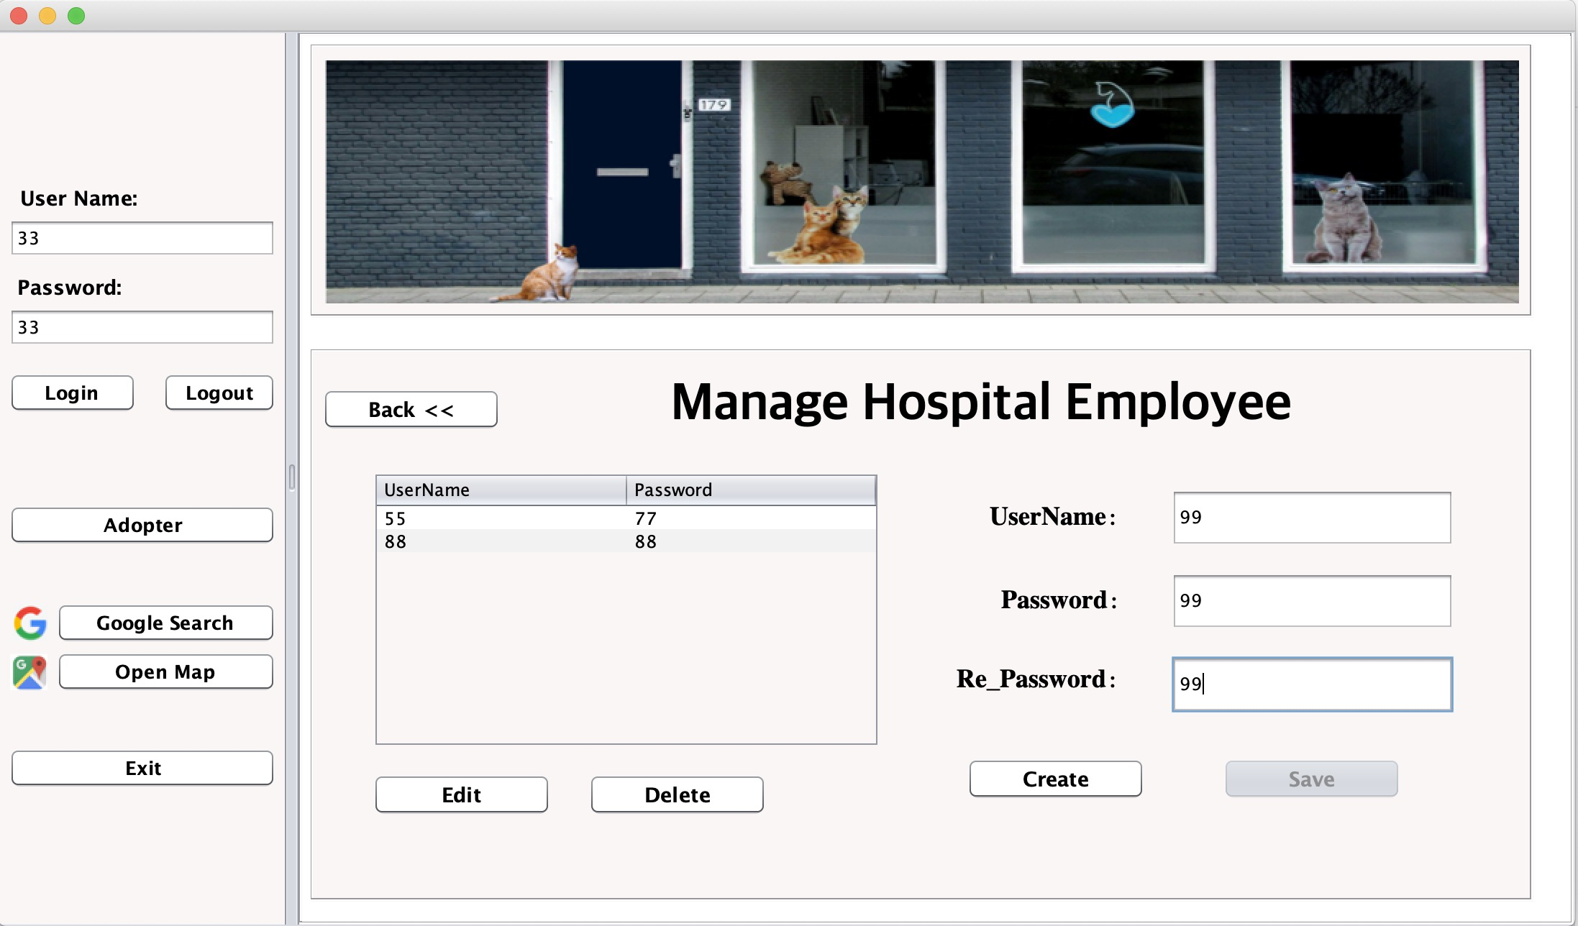

Slide 31
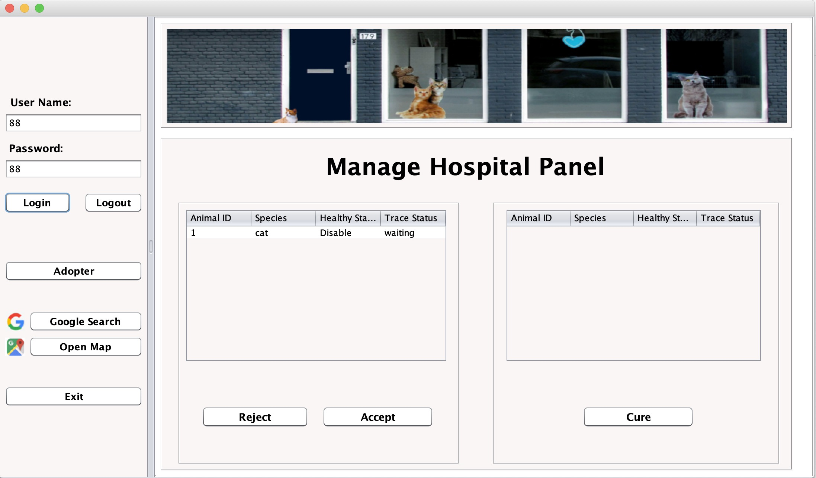

Slide 32
Adopter Center
Login as a manager role or an employee role;
As a manager, I can create, edit or even delete an employee in the adopter center;
As an employee, I can view the request sent from the adopter;
As an employee, after the judgment of whether the adopter could adopt the stray animal, I can approve or reject the requirement;

Slide 33
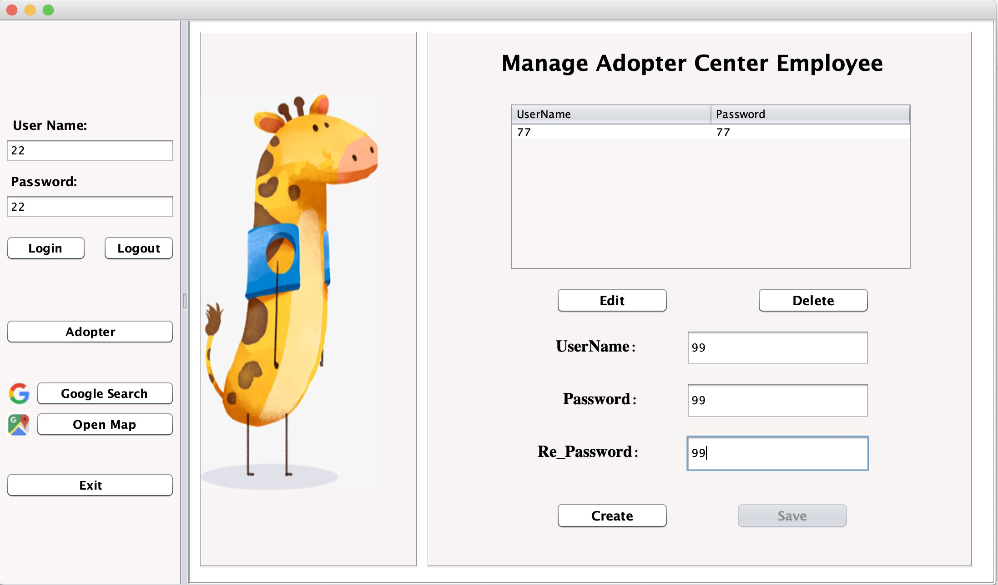

Slide 34
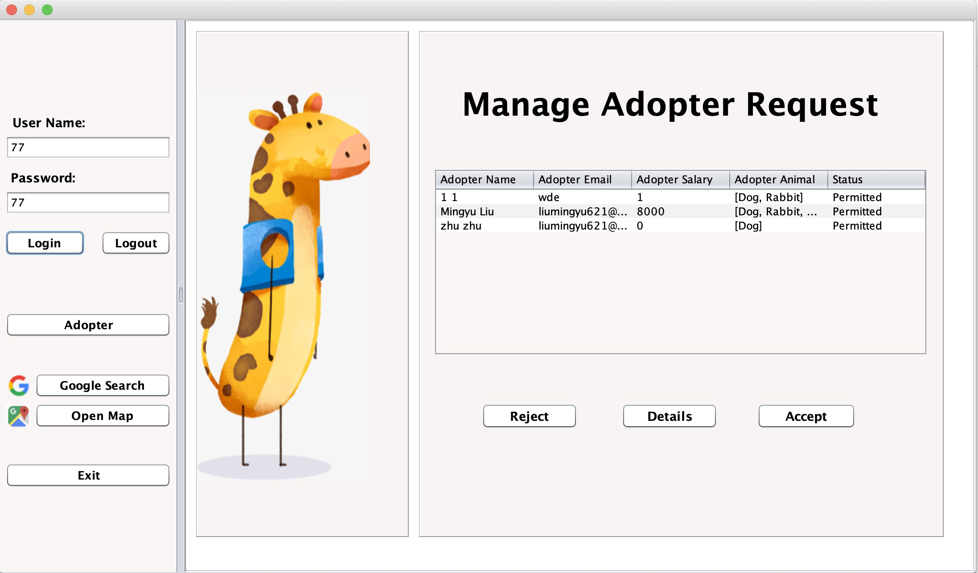

Slide 35
Adopter
Create an account to login to the adopter panel based on existing adopter center;
Add more personal information to create a waiting status for adopting stray animals;
View all the details of the stray animals;
Adopt target stray animal, after getting the permission from the adopter center;
See all the adopted stray animals that the adopter already have;

Slide 36
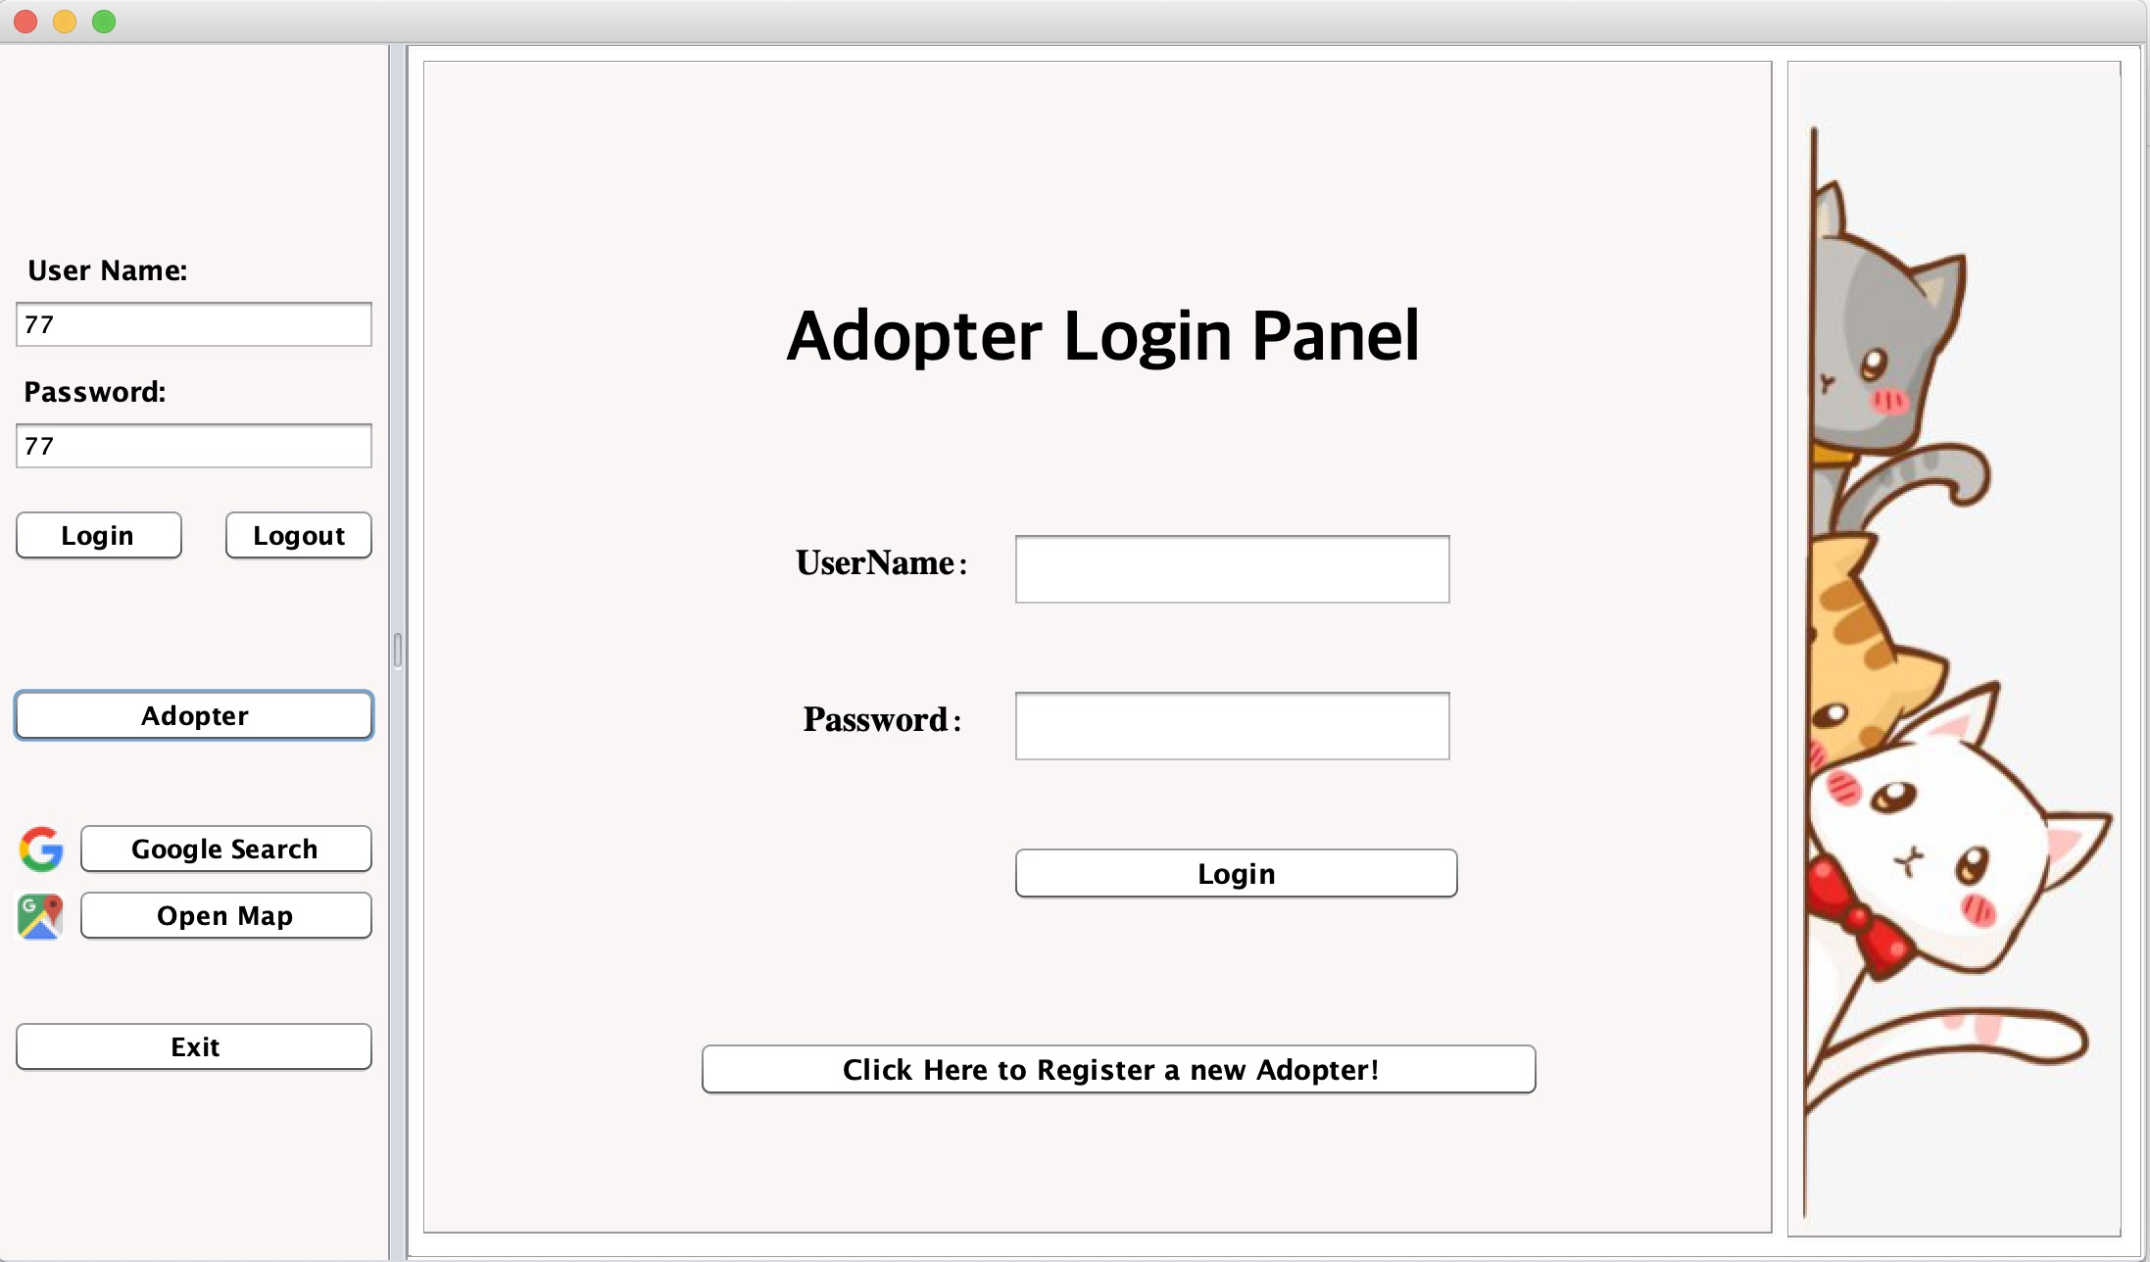

Slide 37
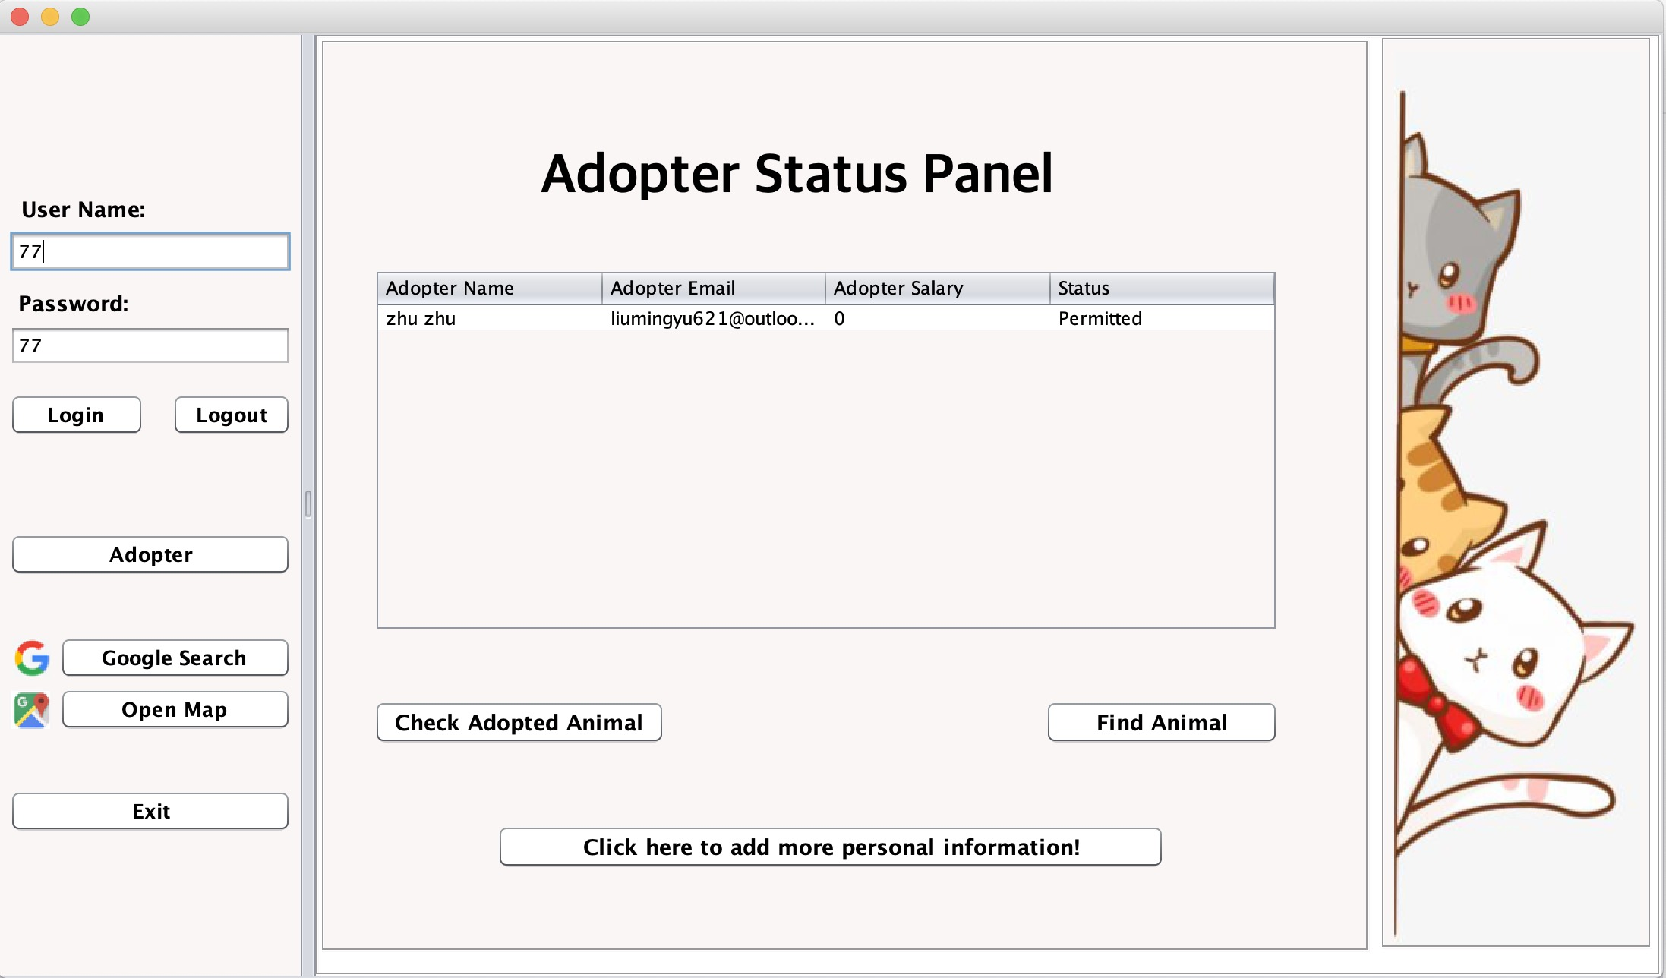

Slide 38
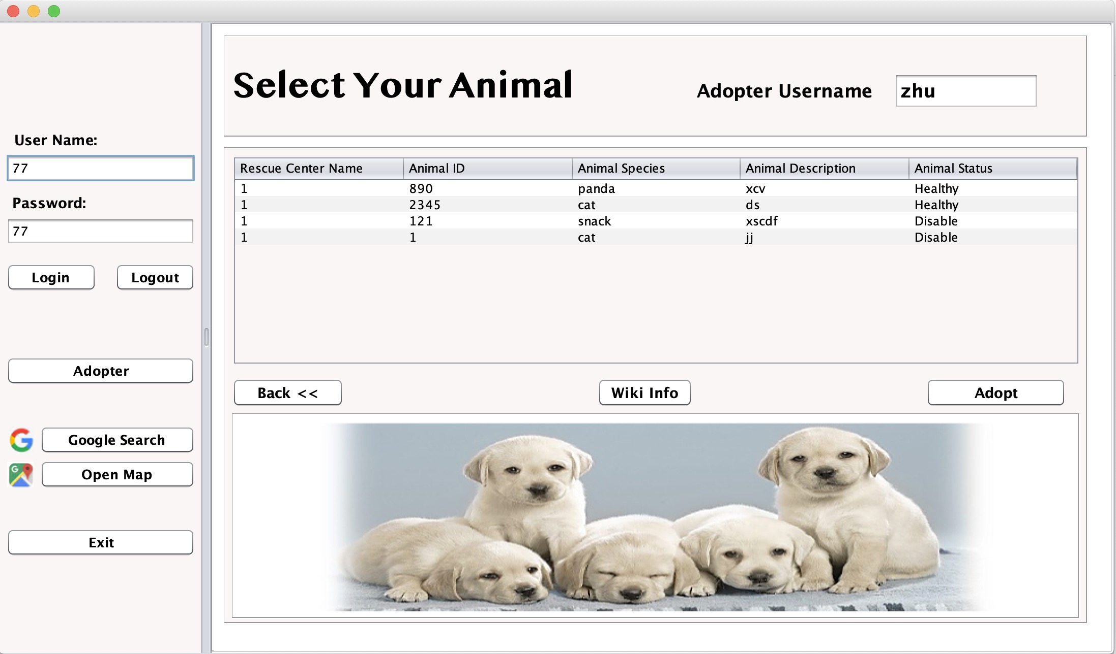

Slide 39
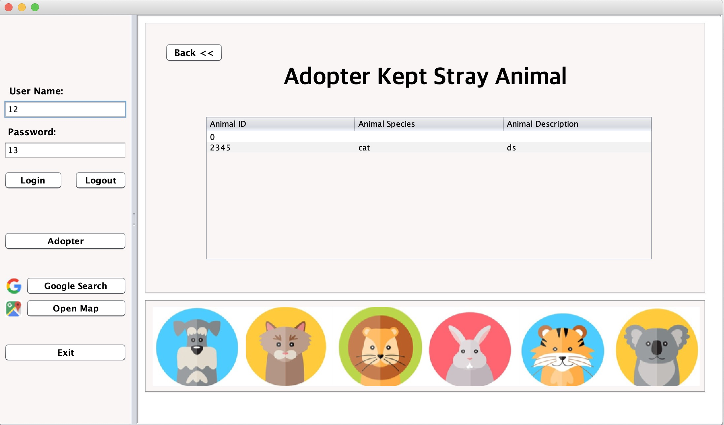

Slide 40
Additional Functions
As an adopter, I need to verify my E-mail address by inputting the verify code sent to my E-mail to register detail information;
As an adopter, if I am wondering whether I could adopt some particular species, I can search it by clicking embedded Wikipedia first;
As an adopter, if I am not sure where my target stray animal or rescue center is, I can search it on the google map to confirm the location;
Adding a google button as a tool bar;

Slide 41
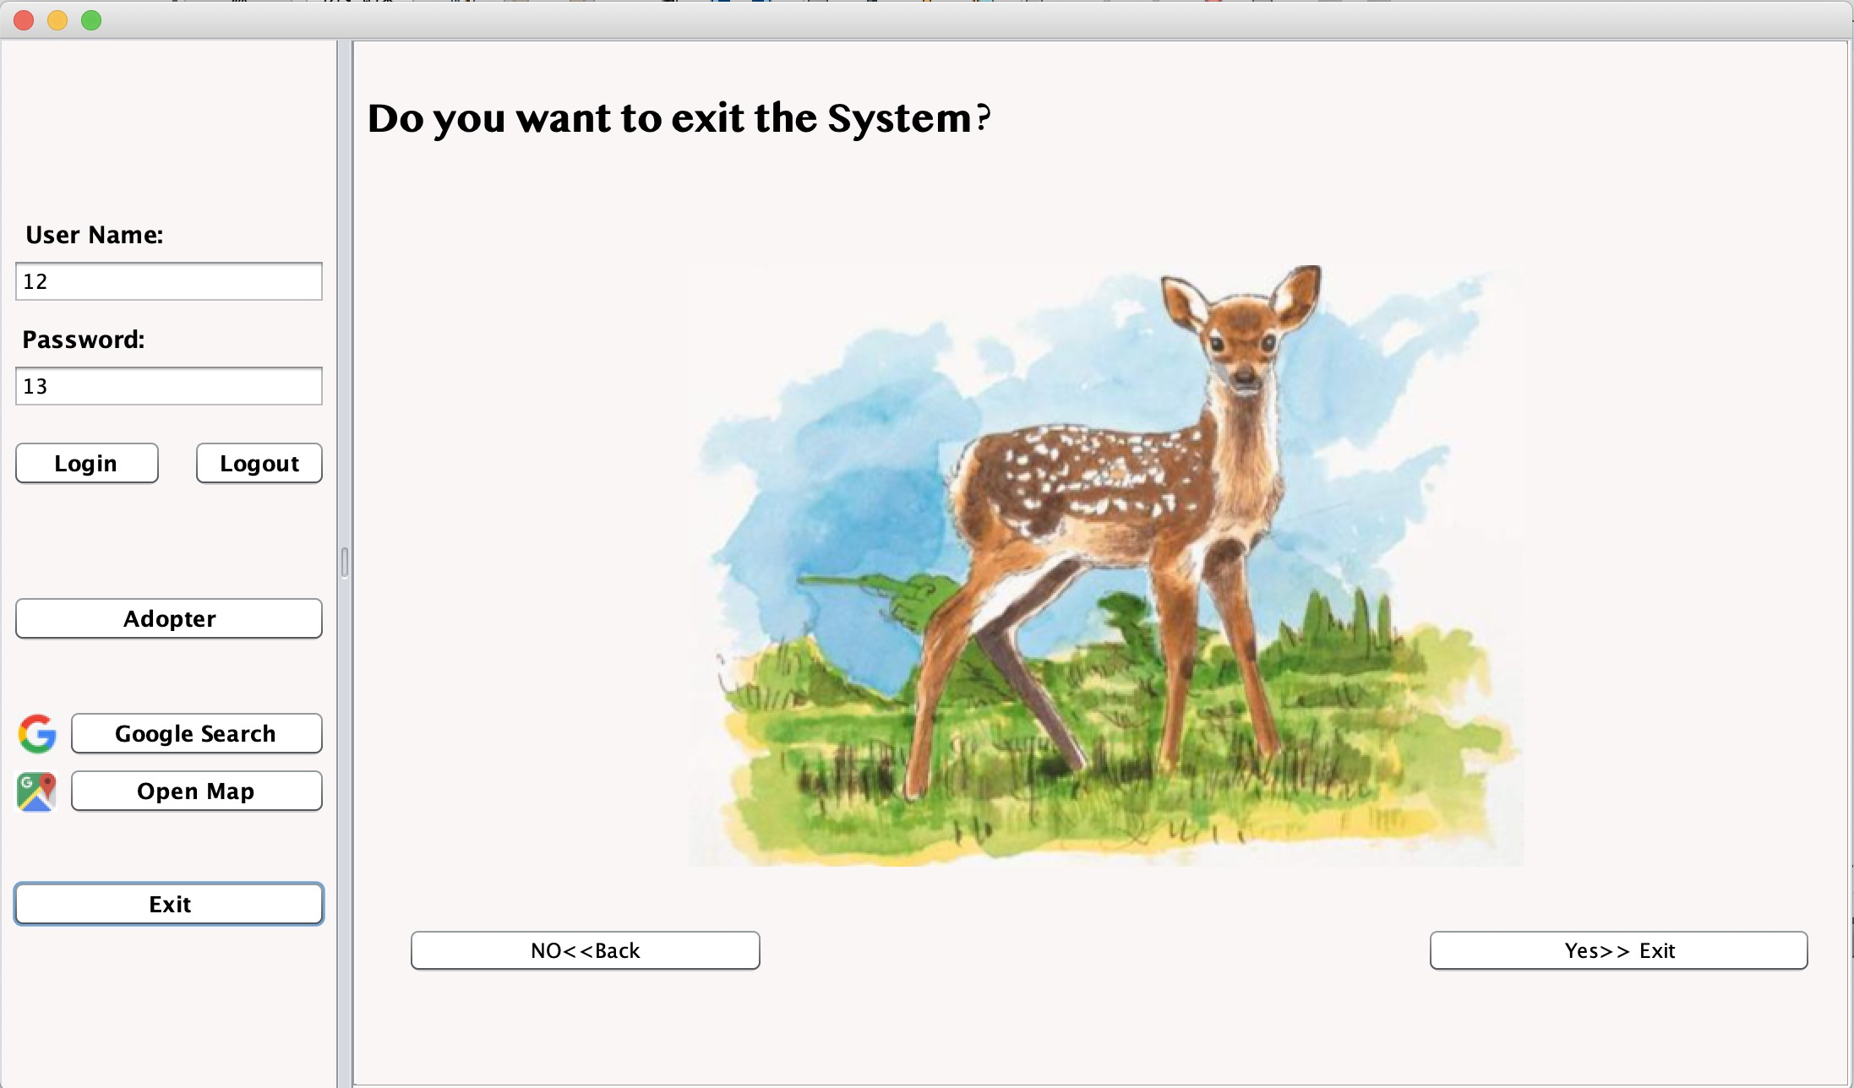

Slide 42

THANKS!

